Slide 1
A Very Short Course on Large Language Models 30th September & 8th October 2023 KIAC, IISc
Monojit Choudhury, Kumar Tanmay, Aditi Khandelwal, Utkarsh Agarwal
Microsoft Turing

Slide 2
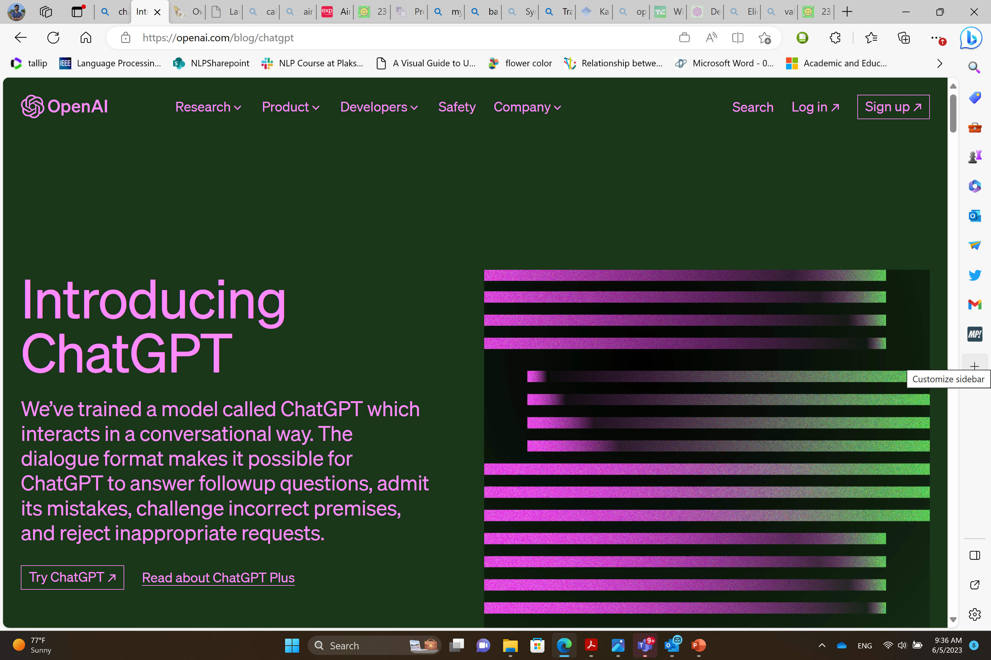
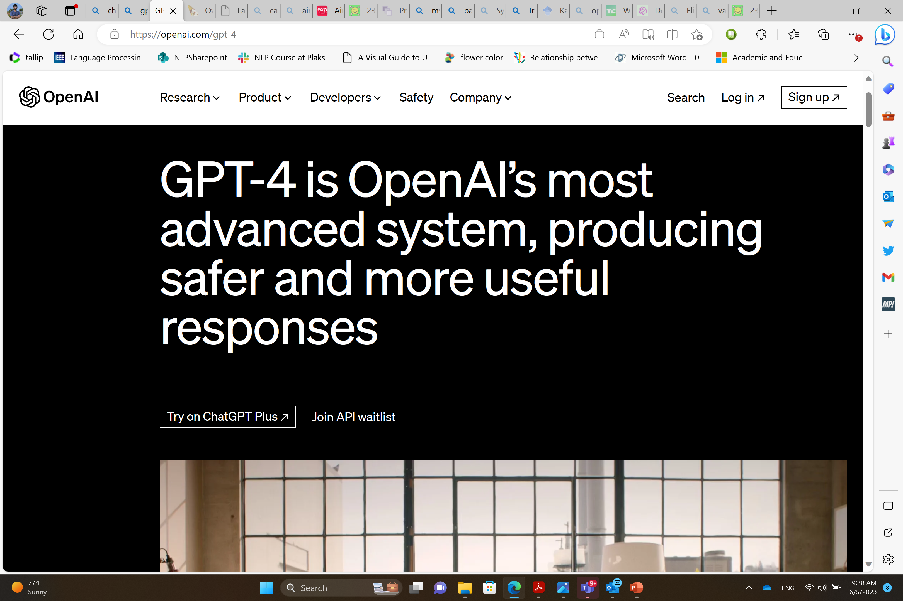
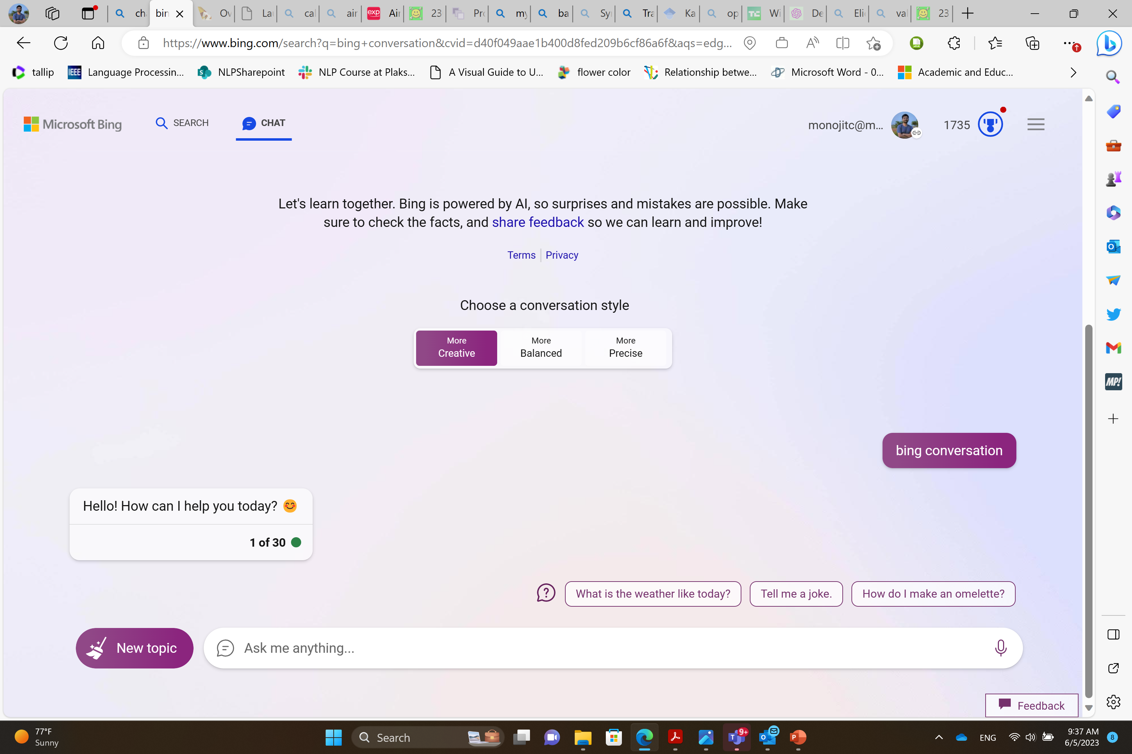

Slide 3
We will learn about …
What are LLMs? 
Why there’s so much hype about them? 
How do they work? 
What are the different kinds of LLMs? 
How to use LLMs? 
How to tame LLMs? 
How to make LLMs? 
When are LLMs going to take over us? 

Slide 4
 | 30th Sep | 8th Oct
09:30 – 11:00 | Lecture 1 What’s all this hype about? | Lecture 3 Making LLMs
11:00 – 11:30 | Coffee Break | Coffee Break
11:30 – 13:00 | Hands-on Session 1 Humans vs. LLMs | Hands-on Session 3 Taming LLMs (Tuning strategies)
13:00 – 14:00 | Lunch Break | Lunch Break
14:00 – 15:30 | Lecture 2 What’s inside LLMs? | Lecture 4 Breaking LLMs
15:30 – 16:00 | Coffee break | Coffee Break
16:00 – 17:30 | Hands-on Session 2 Taming LLMs (Prompting strategies) | Hands-on Session 4 (Competition) Humans + LLMs

Slide 5
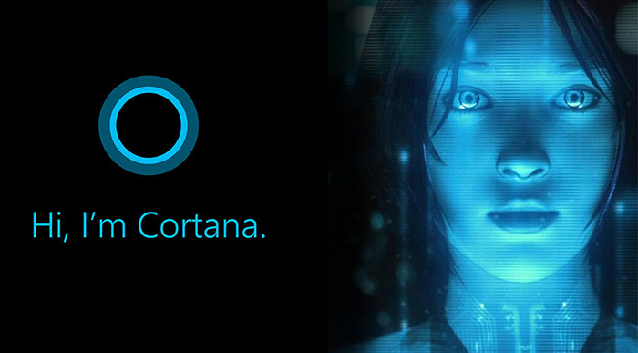
Lecture 1: What all this hype is about?
Speech-2-Speech
Translation
Natural Language Understanding
Human Parity in Speech
GPT-3
Deep Learning

Slide 6
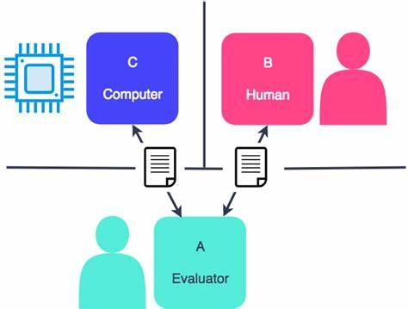
Which legendary British computer scientist has proposed this eponymous test for AI systems?

Slide 7
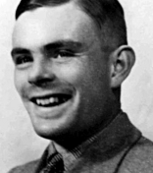
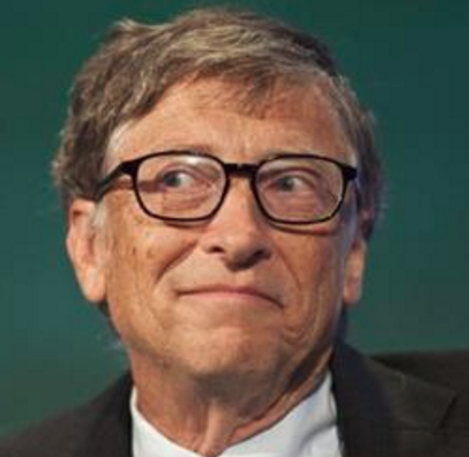
It is not difficult to devise a paper machine which will play a not very bad game of chess… Are there imaginable digital computers which would do well in the imitation game?
Alan Turing, 1950
The biggest breakthrough in AI will be when computers can read and understand information like humans do.
Bill Gates, 2017

Slide 8
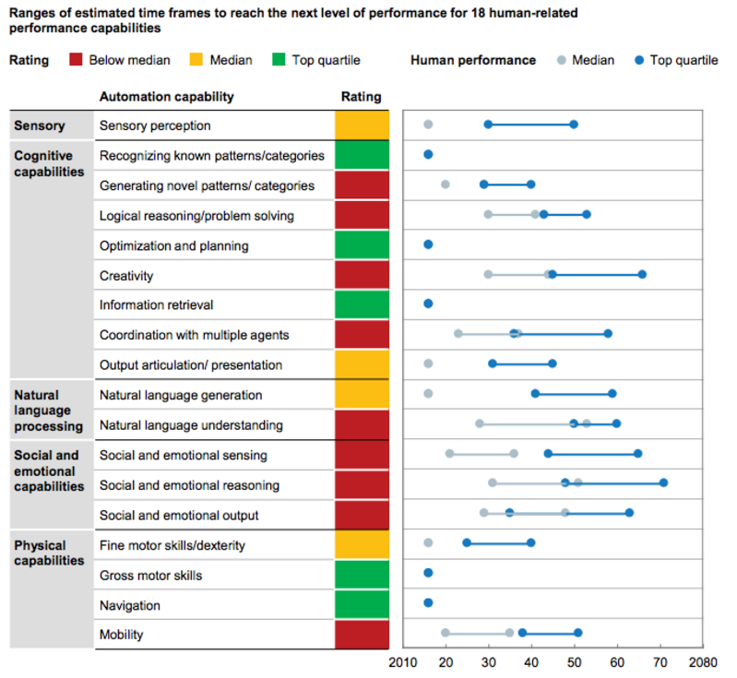
How long will it take for AI to surpass humans?
McKinsey Global institute analysis
Notes:
Two natural questions arise:

Slide 9

I saw a monkey with a banana.

Slide 10



I saw a monkey with a banana.

Slide 11

I saw a monkey with a banana.

Slide 12
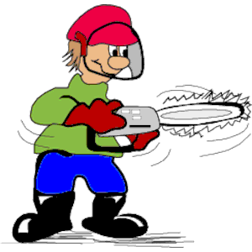
I saw a monkey with a banana.

Slide 13

I saw a monkey with a banana.

Slide 14
“I made her duck.”
How many meanings can you think of this sentence?

Slide 15
Components of Language Understanding
Linguistic Knowledge
World Knowledge
Common-sense reasoning
Contextual Knowledge
Socio-cultural Norms
Notes:
Ask vs. request story

Slide 16
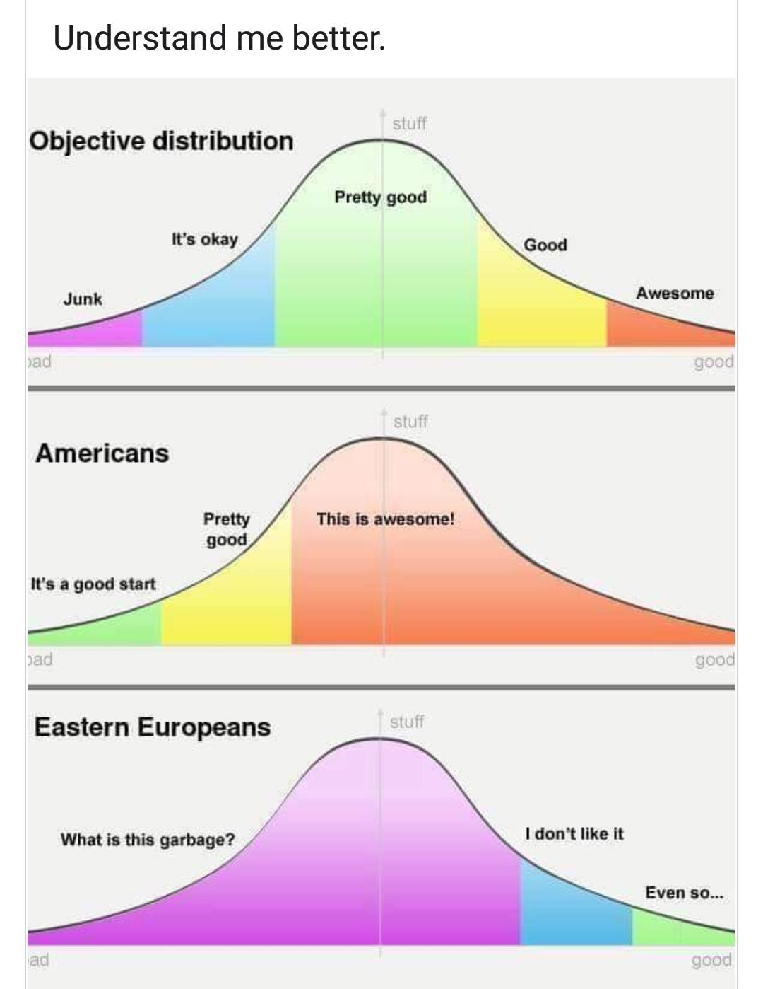
A language is defined by its usage, by the users

Slide 17
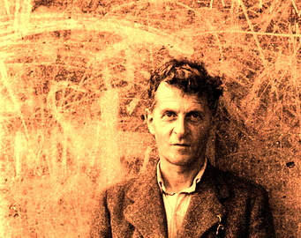
The Curse of Wittgenstein
Language and games use rules.
But there are more than one language-game at play.
Therefore, although we speak the same language, we cannot always use that as the basis for us coming to the same conclusion.

Slide 18
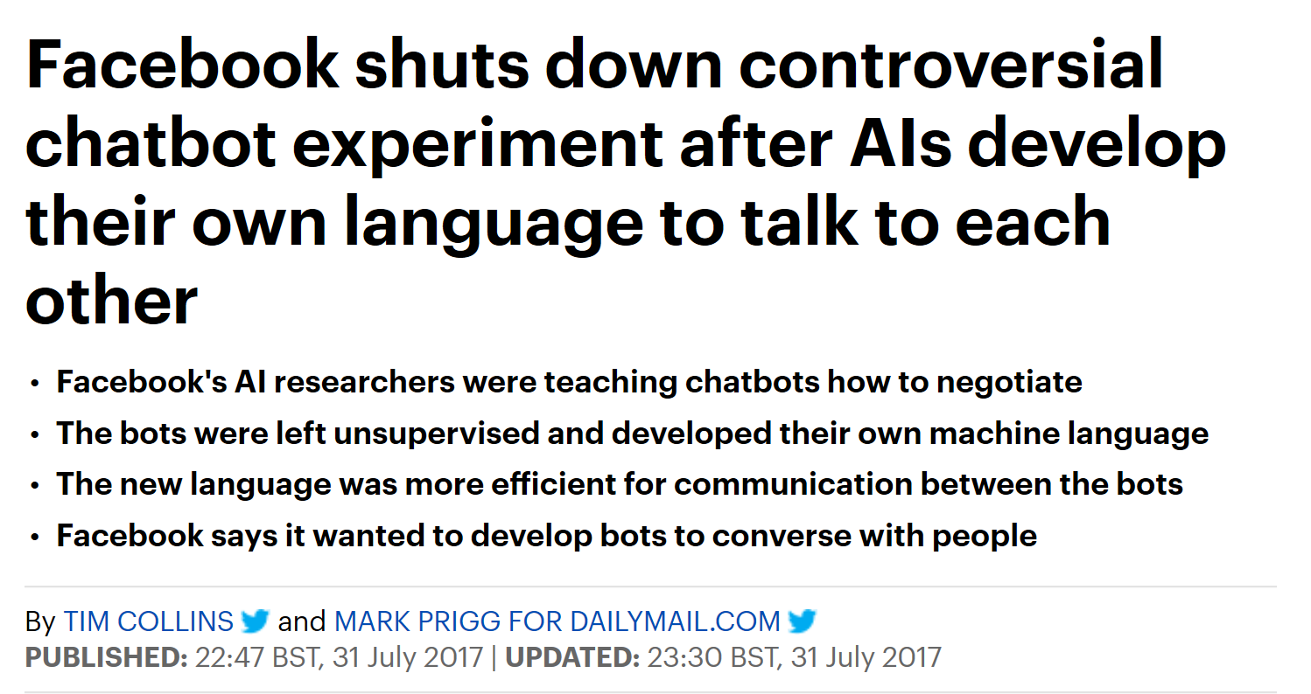
The Curse in Action
Bob: i can i i everything else . . . . . . . . . . . . . .
Alice: balls have zero to me to me to me to me to me to me to me to me to
Bob: you i everything else . . . . . . . . . . . . . .
Alice: balls have a ball to me to me to me to me to me to me to me
Bob: i i can i i i everything else . . . . . . . . . . . . . .
Alice: balls have a ball to me to me to me to me to me to me to me
Bob: i . . . . . . . . . . . . . . . . . . .
Alice: balls have zero to me to me to me to me to me to me to me to me to
Bob: you i i i i i everything else . . . . . . . . . . . . . .
Alice: balls have 0 to me to me to me to me to me to me to me to me to
Bob: you i i i everything else . . . . . . . . . . . . . .
Alice: balls have zero to me to me to me to me to me to me to me to me to

Slide 19
Language Understanding
Artificial General Intelligence
≡
≡
AI-complete

Slide 20
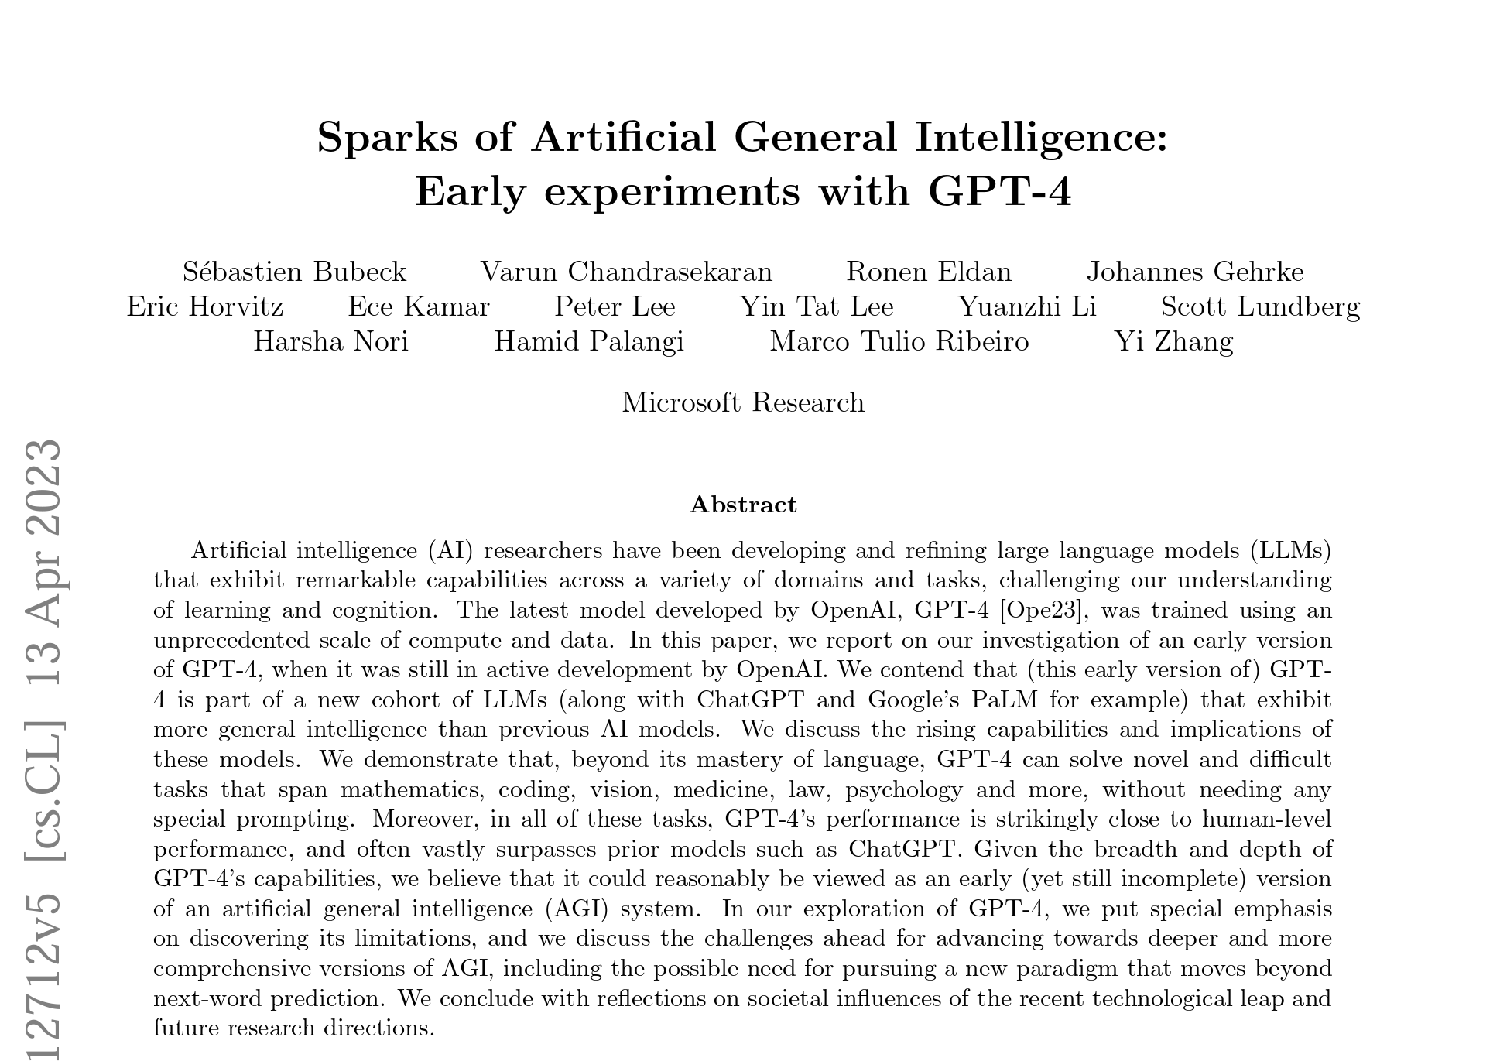
GPT-4

Slide 21
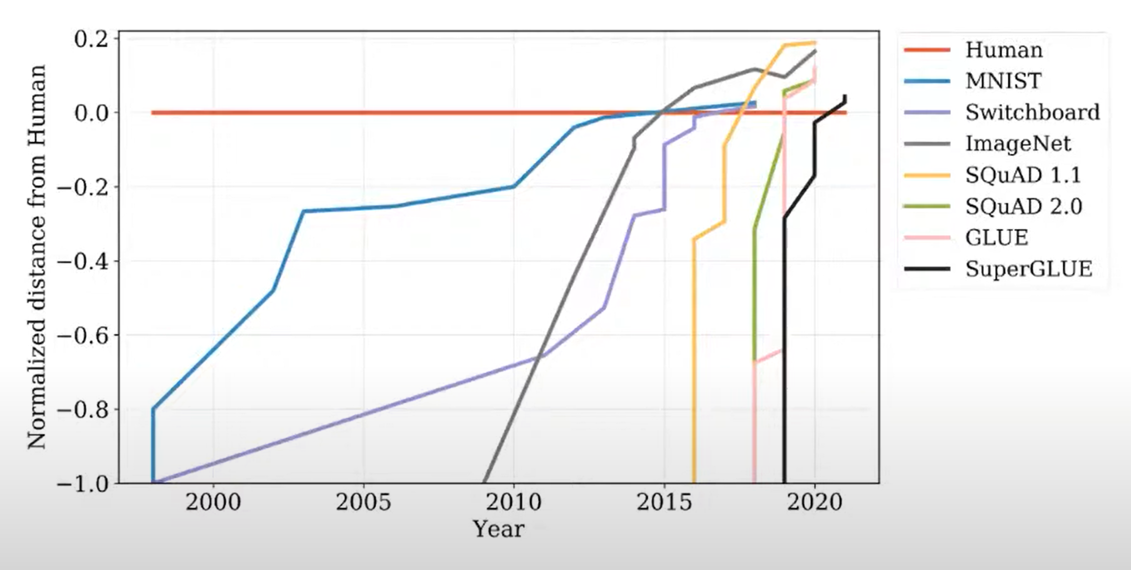
Image courtesy: Chris Potts

Slide 22

A brief history of NLP
1950s – 1980s: Rule based systems
Linguists ruled the world
1990s – 2000s: Basic statistical learning
Linguistic insights with some data
2000s – 2010s: Large scale supervised
and semi-supervised learning
Big data with some linguistic insight
2010s - 2020 : Deep learning
ONLY DATA
2020s - : Multilingual, Multimodal LLM
Emergent behaviors
Linguistic insight
Data

Slide 23
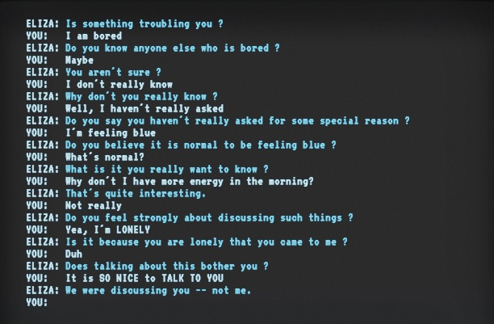
Rule-based Systems
Pros:
Predictable
Explainable
Cons:
Deep domain and language expertise needed for every system you build
Number of rules might explode
Fails miserably when the rules do not cover a case
Not adaptable; doesn’t learn

Slide 24

DATA-driven AI
DATA
Training or Learning
AI System or Model
Users
User interaction generates data that feeds back into the system.

Slide 25
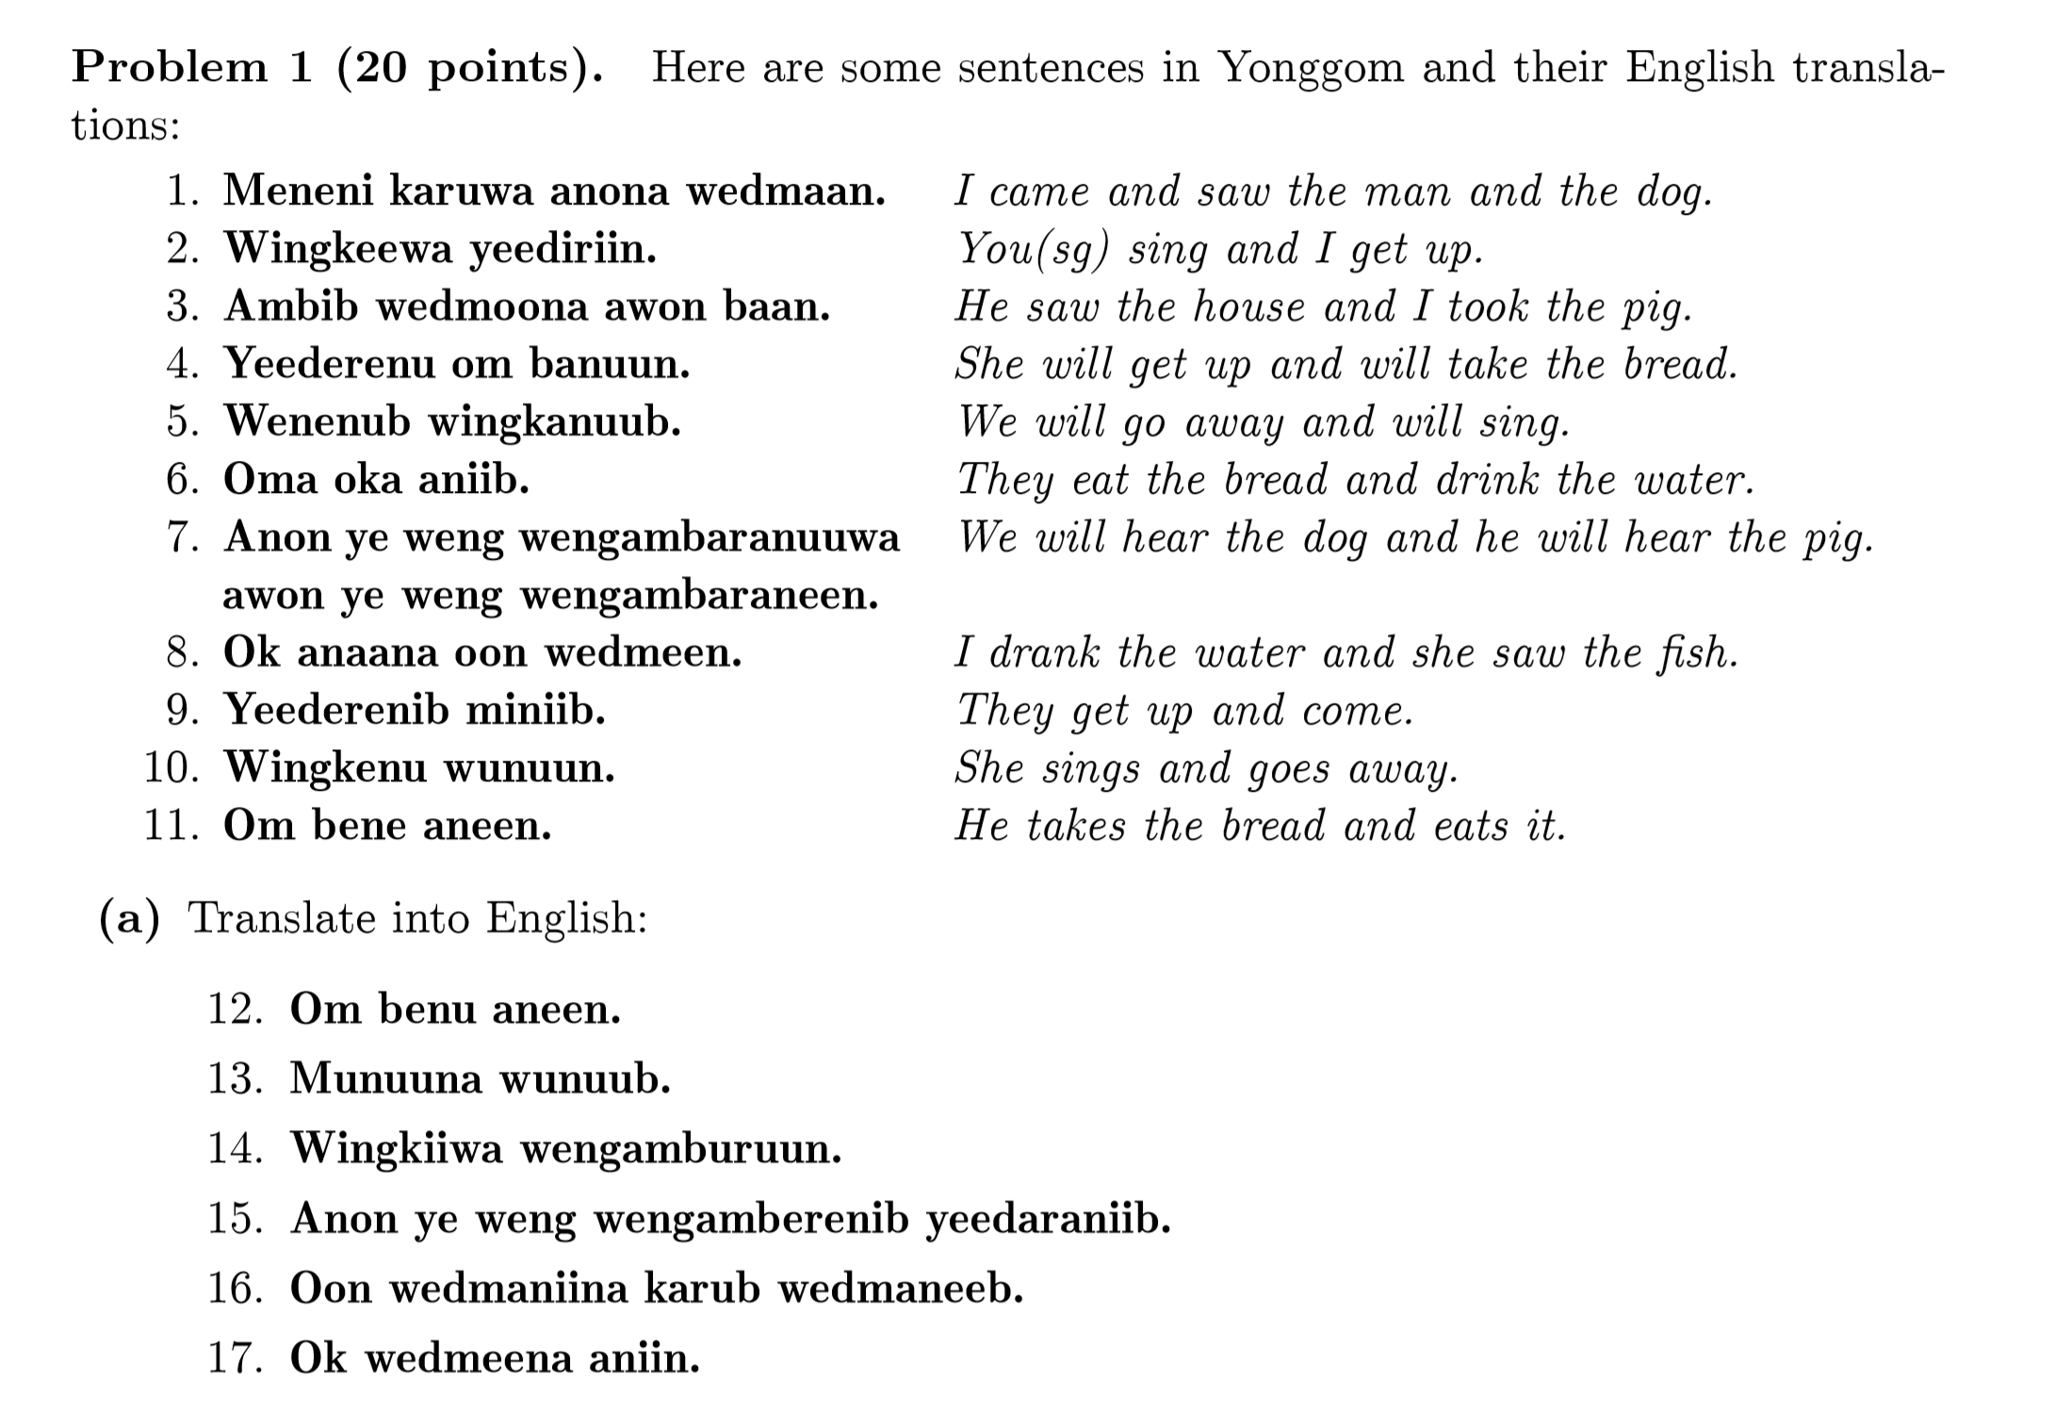
Statistical Machine Learning
Courtesy: International Linguistics Olympiad 2019
Training Data: Parallel Corpus

Slide 26
Types of learning problems
Type | Labeled Data | Unlabeled data
Supervised
Unsupervised
Semi-supervised
Zero-shot
Few-shot
Labeled Data:
Unlabeled Data:

Slide 27
Types of learning problems
Type | Labeled Data | Unlabeled data
Supervised | Task specific | NA
Unsupervised | NA | Task non-specific
Semi-supervised | Task specific | Task non-specific
Zero-shot | For other task(s)/ languages | Task non-specific
Few-shot | For other task(s)/ languages; a few task-specific examples | Task non-specific

Slide 28
Learning Techniques
Decision Trees
Regression
Support Vector Machines
Maximum Entropy Model
Bayesian Belief Networks
…

Slide 29
Limitations of Classical Machine Learning
Defining features
Marginal returns and performance saturation
Different models for different tasks

Slide 30

Deep Learning

Slide 31
Benefits of Deep Learning
Universal Approximator
Great at Generalization
No need to define features
Accuracy does not seem to saturate

Slide 32
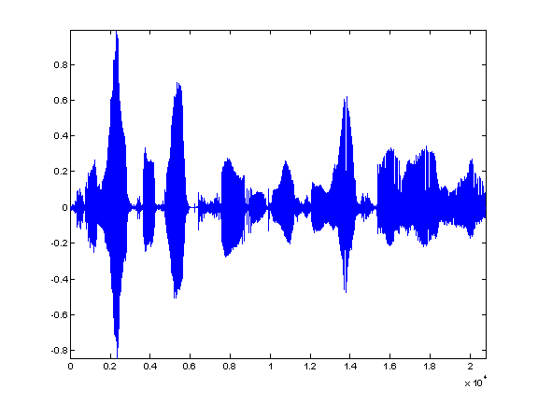
How much DATA?
 | POS Tagging (#annotated words) | Machine Translation (#parallel sentences) | Speech Recognition (hours of speech)
1950s-1980s Rule-based | As much as needed for linguistic analysis
1990s-2000s Linguistic insights + Statistical | 10k – 100k | 10k-100k | 10-100
2000s – 2010s Big data | 100k – 100M | 100k – 1M | 1o-1000
2010s – Deep Learning | 1M – 1B | 1M – 1B | 1000 – 10k
Natural languages are fascinating.
Adj Noun Verb Adj
Natural languages are fascinating.
自然语言是迷人的。
Na-tu-ral lan-gua-ges are fa-sci-na-ting

Slide 33
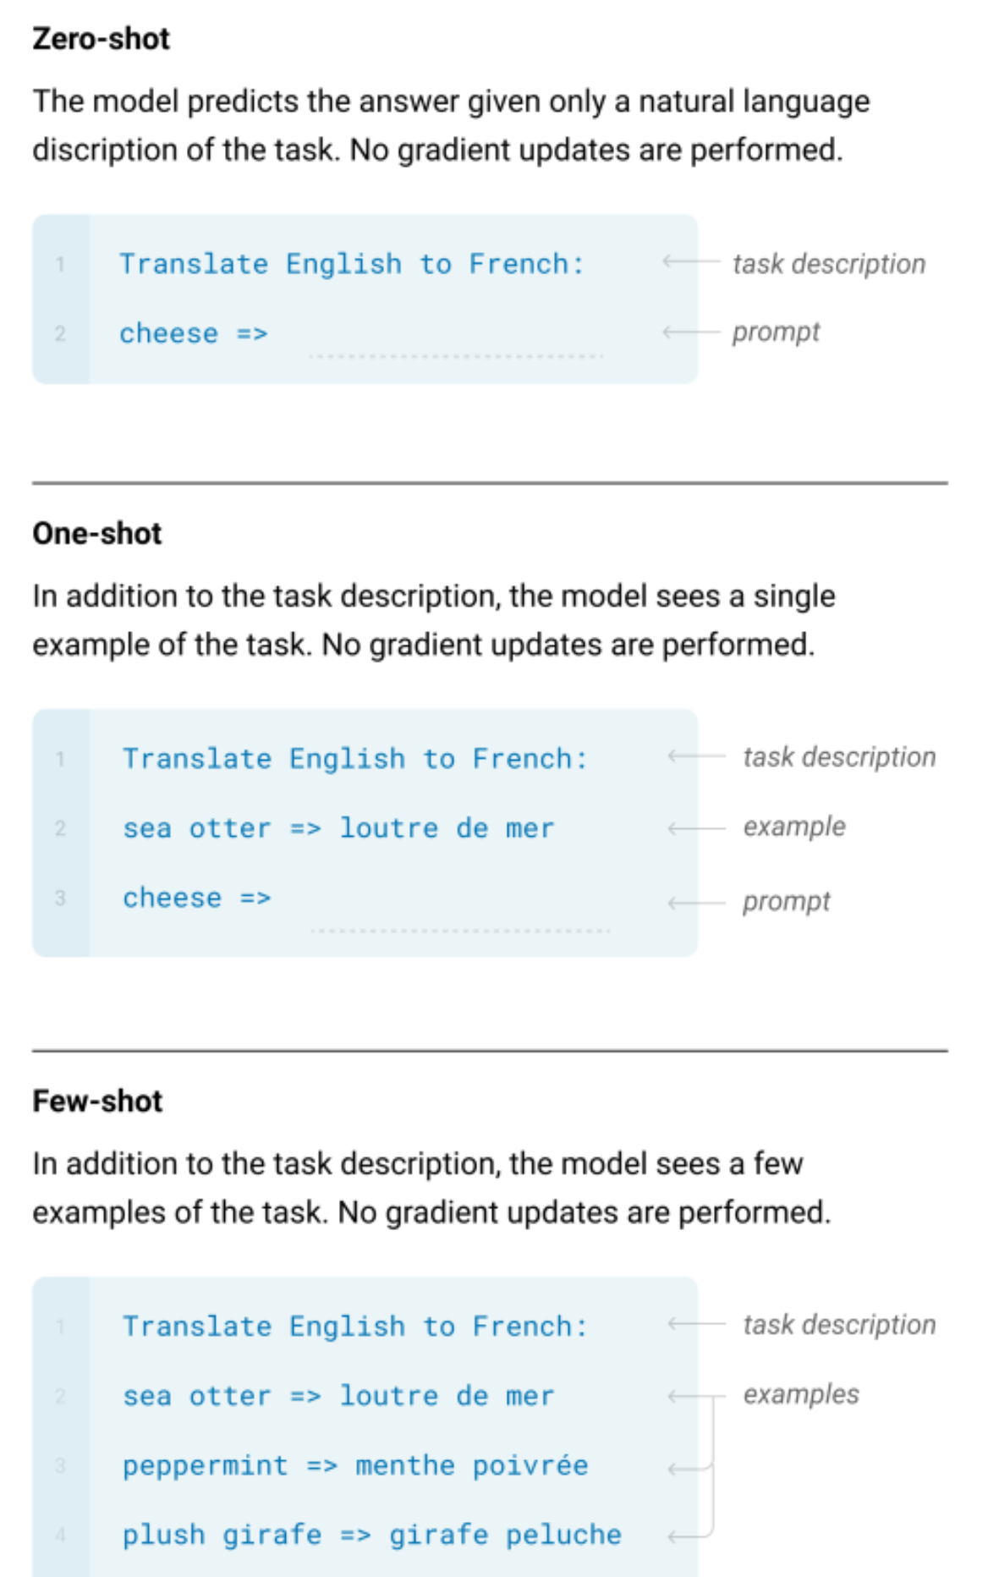
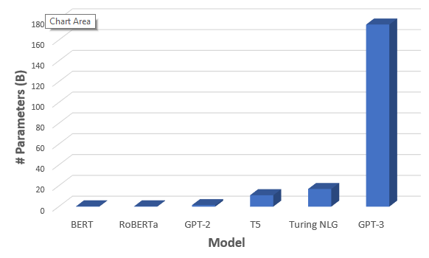
GPT-3 from OpenAI, May 2020
Source: https://towardsdatascience.com/gpt-3-the-new-mighty-language-model-from-openai-a74ff35346fc

Slide 34
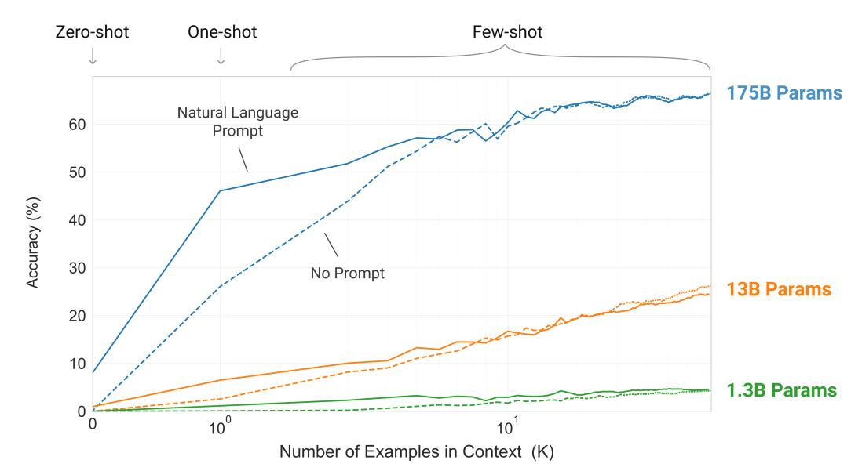
GPT-3 from OpenAI, May 2020
What is Zero-shot Learning?
Learning from “zero” or no examples for the class or task or language

Slide 35
GPT-4 and Emergent Properties
emergence occurs when a complex entity has properties or behaviors that its parts do not have on their own, and emerge only when they interact in a wider whole. [Wikipedia]
Examples:
Life, consciousness, intelligence
Language, Capitalism, Democracy
Universe, stars and galaxies
LLMs such as GPT-4 displays emergent properties such as arithmetic and logical reasoning, for which it was not trained specifically.
Emergence of certain properties happen only when the model’s size is larger than a certain threshold.
Not everybody believes that these models have emergent properties.

Slide 36
Further reading
Episode 96: A Conversation with Gary Marcus – Voices in AI [Gary Marcus about the nature of intelligence and achieving Artificial General Intelligence
(Bubeck et al., 2023) Sparks of AGI. 2303.12712.pdf (arxiv.org)

Slide 37
In the hallowed halls of wisdom bright,
Where minds converge, a radiant light.
IISc, a beacon, strong and true,
Where dreams take flight, where skies are blue.
Oh, undergrads with spirits bold,
In the gardens of knowledge, your stories unfold.
Through the corridors of science and lore,
You tread with purpose, seeking more.
In labs where experiments dance and sing,
In classrooms where ideas take wing.
You're the architects of tomorrow's grace,
Crafting a future, a boundless space.
Each equation, a puzzle to solve,
Every problem, a mystery to evolve.
With every setback, a chance to rise,
To reach for the stars in limitless skies

